Slide 1
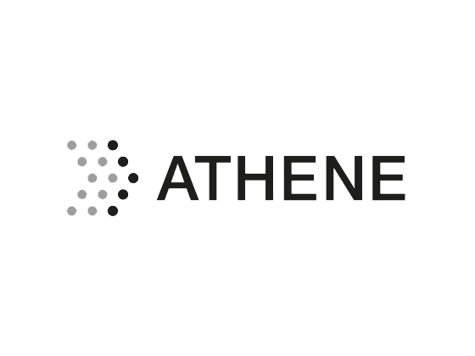


A Probabilistic Choreography Language for PRISM
Adele Veschetti
Technische Universität Darmstadt
IMT Lucca
11th February 2025

Slide 2


About me
Adele Veschetti adele.veschetti@tu-darmstadt.de
Postdoctoral Researcher in the Software Engineering Group at TU Darmstadt
PhD at University of Bologna in 2023
Formal Methods: Application of formal methods in various domains
Focused in blockchain protocols and smart contract verification

Slide 3
outline
1 Background
2 Choreographic Language
3 PRISM Language
4 Projection
5 Implementation
6 Conclusions

Slide 4
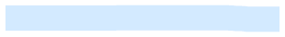

THIS TALK
A Probabilistic Choreography Language for PRISM
Joint work with Marco Carbone
IT University of Copenhagen
Winner of Best Paper Award at COORDINATION 2024

Slide 5
BACKGROUND

Slide 6
MODEL CHECKING
What is Model Checking?
A formal verification technique used to systematically explore the state space of a system
Ensures a system satisfies a given specification (e.g., safety or liveness properties)
How it works
Applications
Hardware verification, software verification, protocol verification, and many more
Limitations
State space explosion, scalability issues, abstraction and modeling errors, and many more

Slide 7
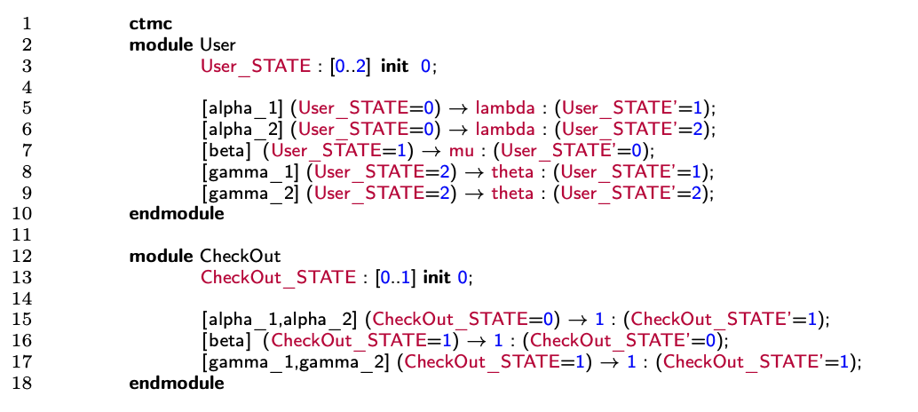
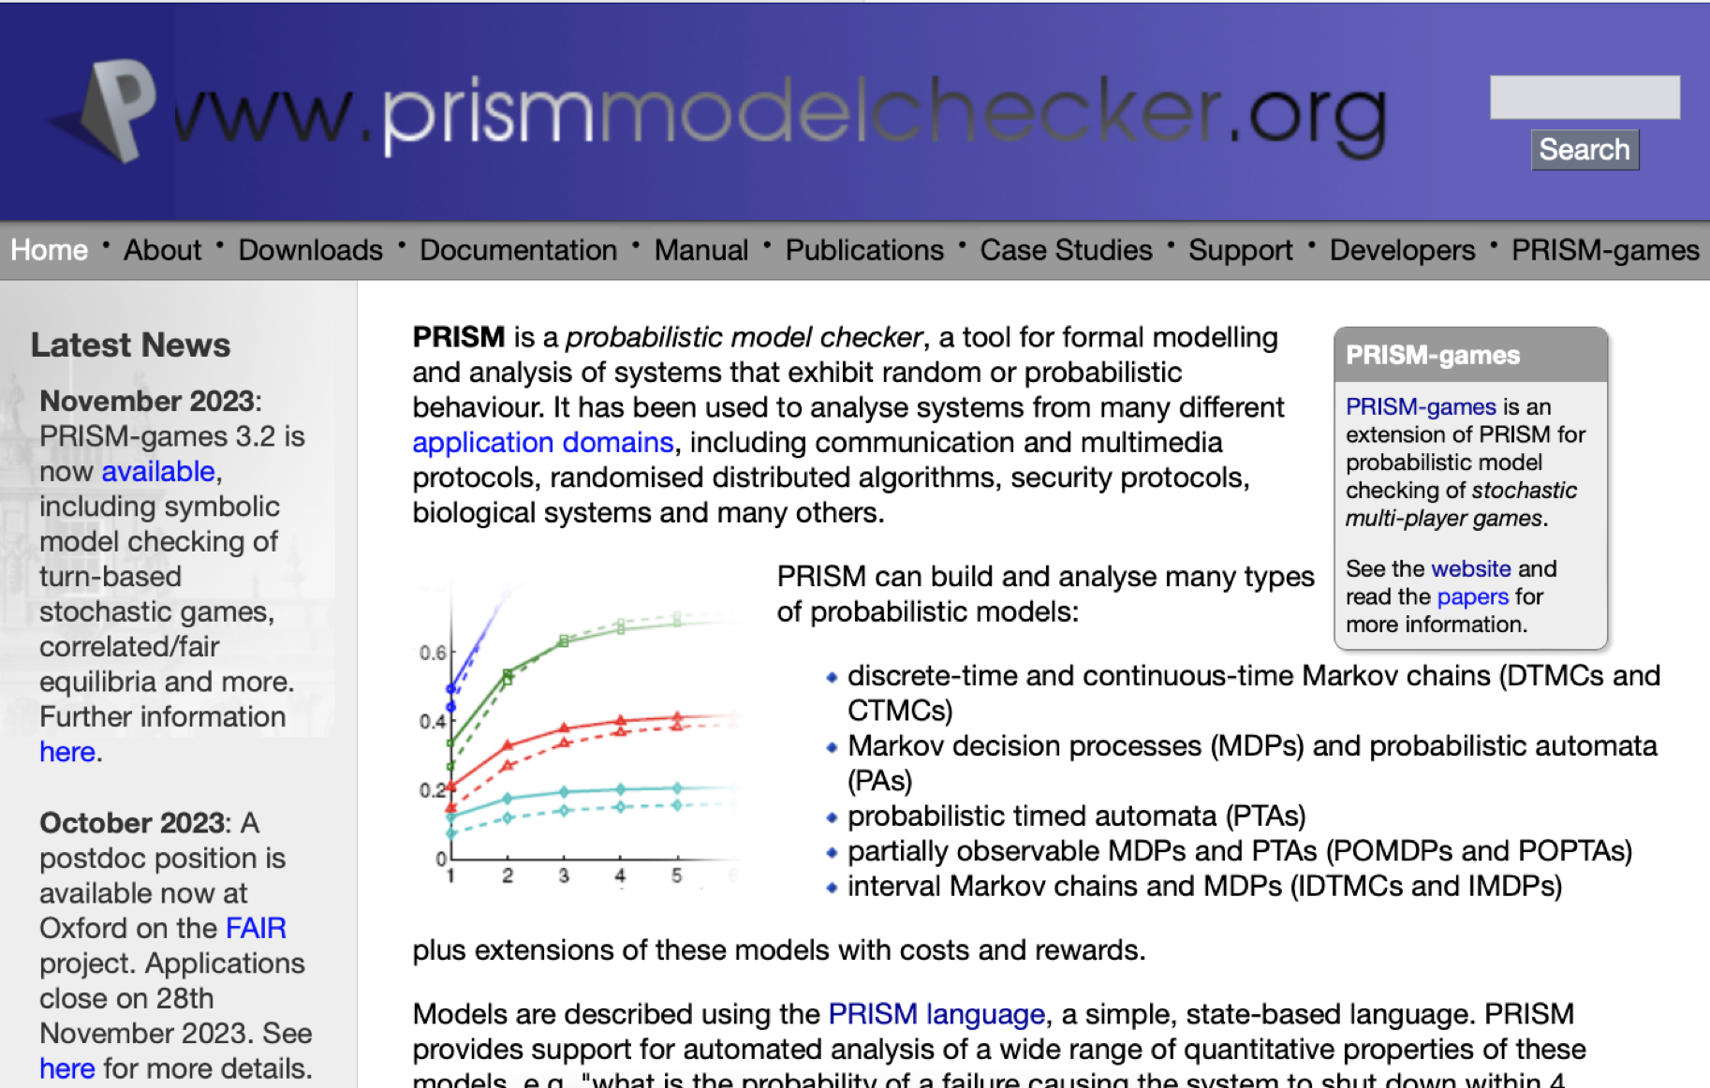
Prism¹
PRISM has a declarative approach
Very easy to add commands
Very hard to predict what their effect is on the system as a whole
PRISM language for modelling concurrent systems
Based on a declarative version of CSP (with probabilities/rates)
https://www.prismmodelchecker.org/
Conditions
Rates
Labels
High risk of modelling something else than what was intended
Updates
[1] Marta Kwiatkowska, Gethin Norman and David Parker. PRISM 4.0: Verification of Probabilistic Real-time Systems. In Proc. 23rd International Conference on Computer Aided Verification (CAV’11), volume 6806 of LNCS, pages 585-591, Springer, 2011

Slide 8
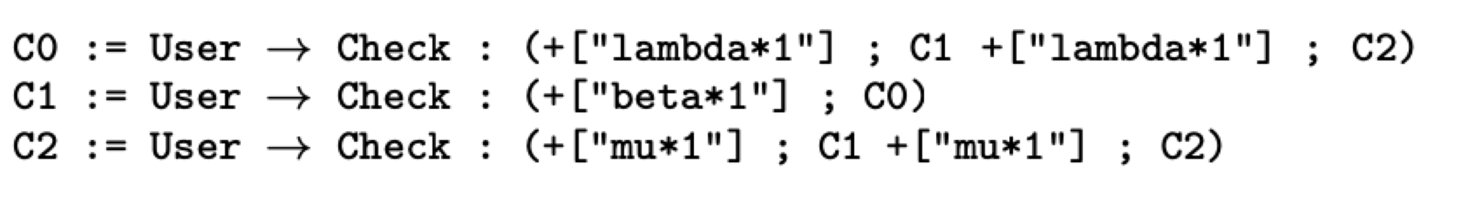
choreographies
Describe communication-based systems focusing on global flow of messages
Global viewpoint of an entire system
Entities have a common goal
No single point of control
Only focus on communications
Facilitate the automatic generation of decentralised implementations
3 Choreographies
Continuations
Processes Interactions

Slide 9
example

Slide 10
MOTIVATION
High level language for concurrent systems that compiles into PRISM
Advantage: higher abstraction => easier to write correct things

Slide 11
CHOREOGRAPHIC LANGUAGE

Slide 12



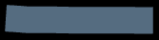

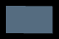
syntax
Interaction initiated by module p with modules p_{i}
λ_{j} denotes either a probability or a rate
Once a branch j is taken, the choreography will execute some assignments u_{j}
If-Then-Else: module p evaluates the guard E and then branches accordingly
(Possibly recursive) procedure call
End of the computation
Assignment: the value obtained by evaluating expression E is assigned to variable x
Update: assignments can be concatenated with the operator &

Slide 13
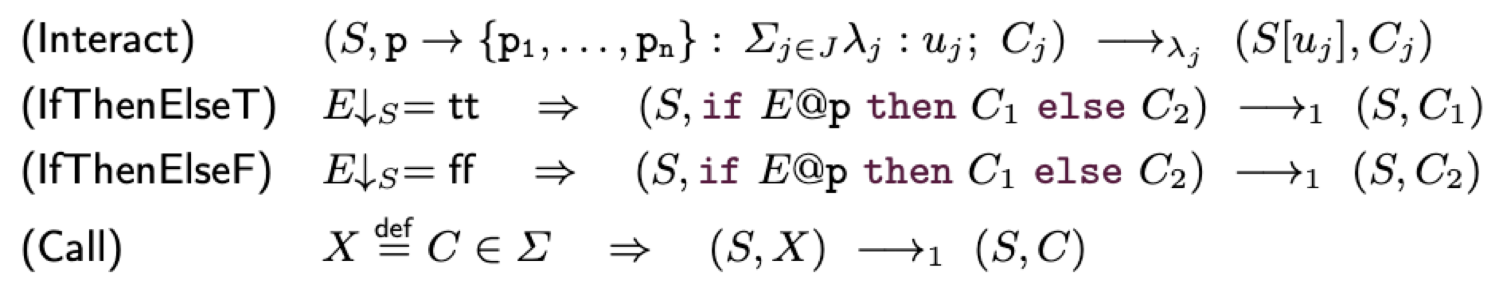
semantics

Slide 14
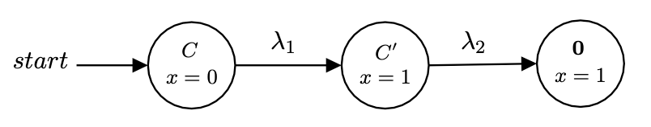
First Example
Semantics of C from the state S(x) = 0

Slide 15
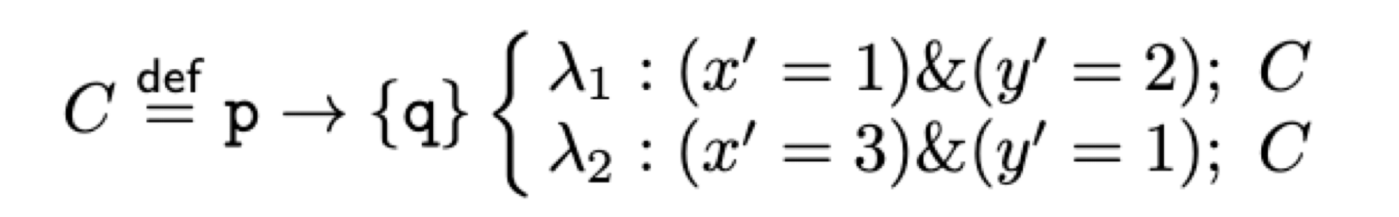
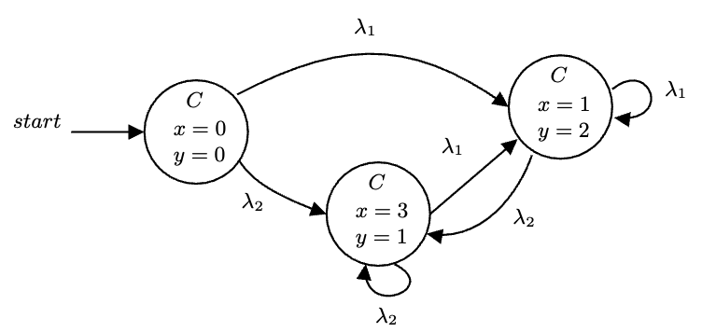
SECOND Example
Semantics of C from the state S(x) = S(y) = 0

Slide 16
PRISM LANGUAGE

Slide 17
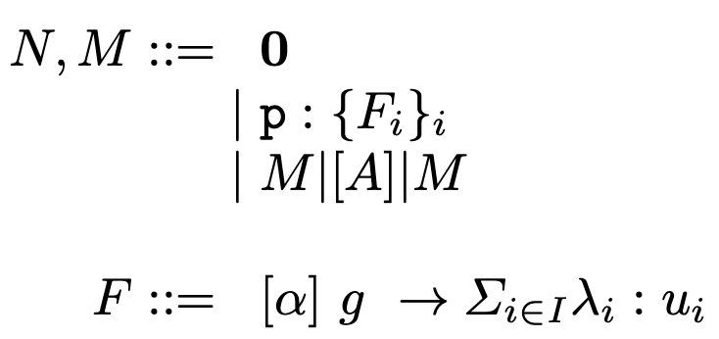



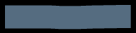

syntax
Networks
Empty Network
Module
Parallel Composition
Commands

Slide 18
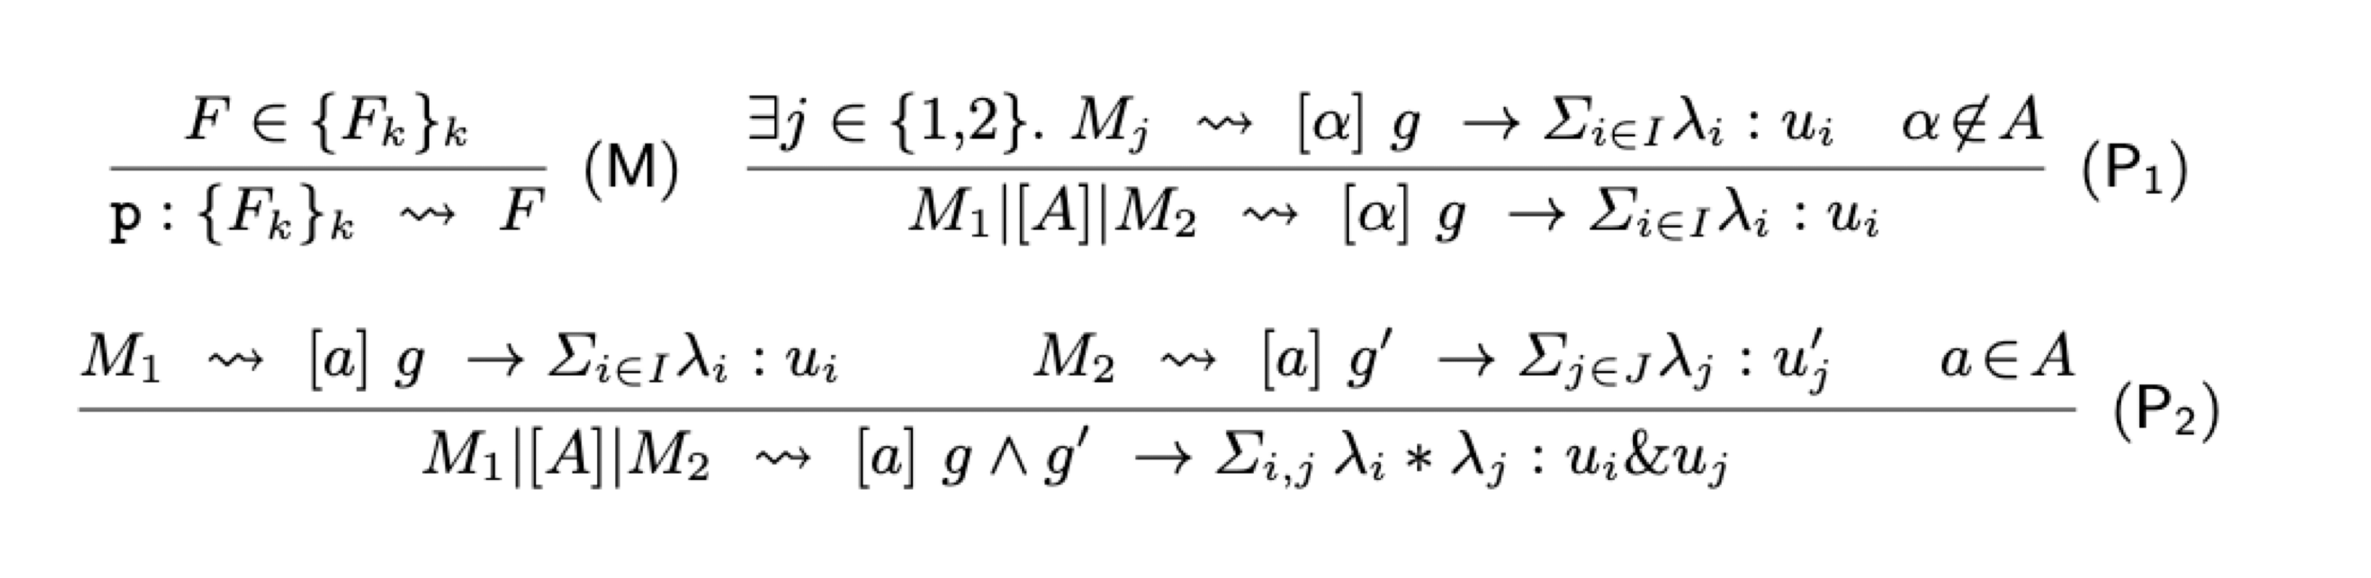



semantics
(M) exposes a command at network level
(P1) propagates a command through parallel composition if α is empty or a is not in A
(P2) the product of the probabilities/rates must be taken by extending the two different branches to every possible combination

Slide 19
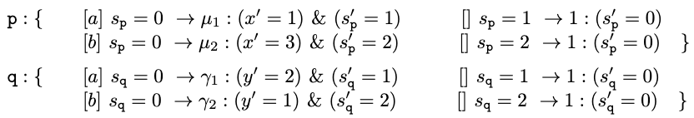
example
Applying the semantics:

Slide 20
PROJECTION

Slide 21
ANNOTATIONS
To simulate a choreography interaction in PRISM,
we need to use labels on which each involved module can synchronize
Each interaction in a choreography is annotated with a unique label

Slide 22
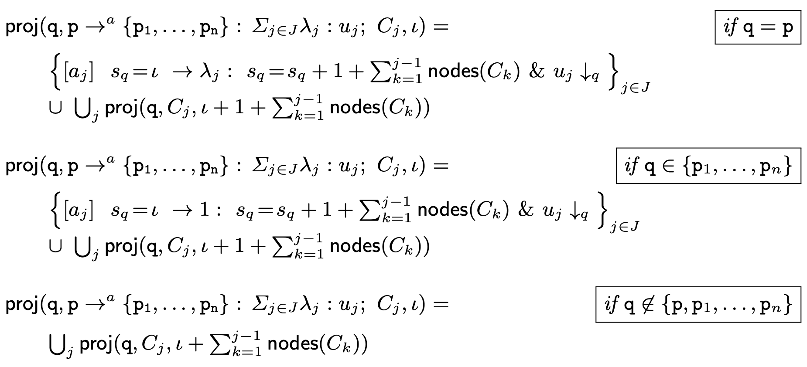
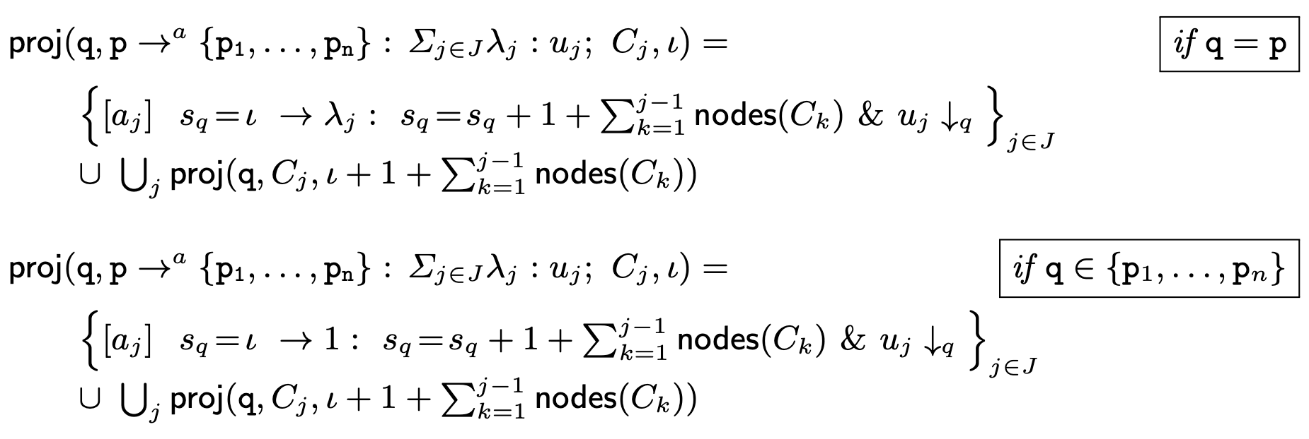
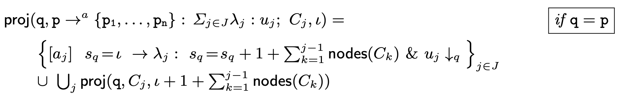
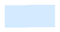
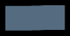
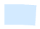

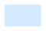

CTMC
Annotated choreographies
a label and an integer identify a node
s_{q} is the counter for this module
nodes(C) returns the number of nodes of C

Slide 23
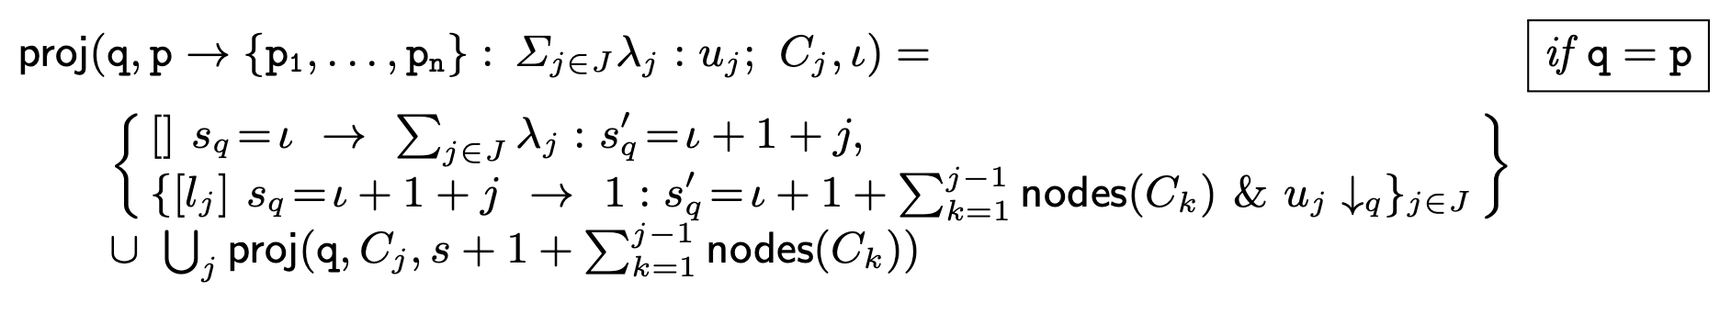
DTMC

Slide 24
example

Slide 25
correctness
Our projection operations are correct with respect to the semantics of choreographies and PRISM

Slide 26
IMPLEMENTATION & BENCHMARKING

Slide 27





IMPLEMENTATION
In Java, ANTLR
Available at https://github.com/adeleveschetti/ChoreoPRISM
Generates PRISM code that needs to be fed to PRISM
Implementation offers extra language constructs
Parametric modules renaming

Slide 28
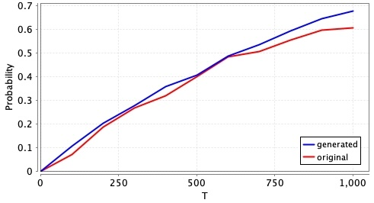
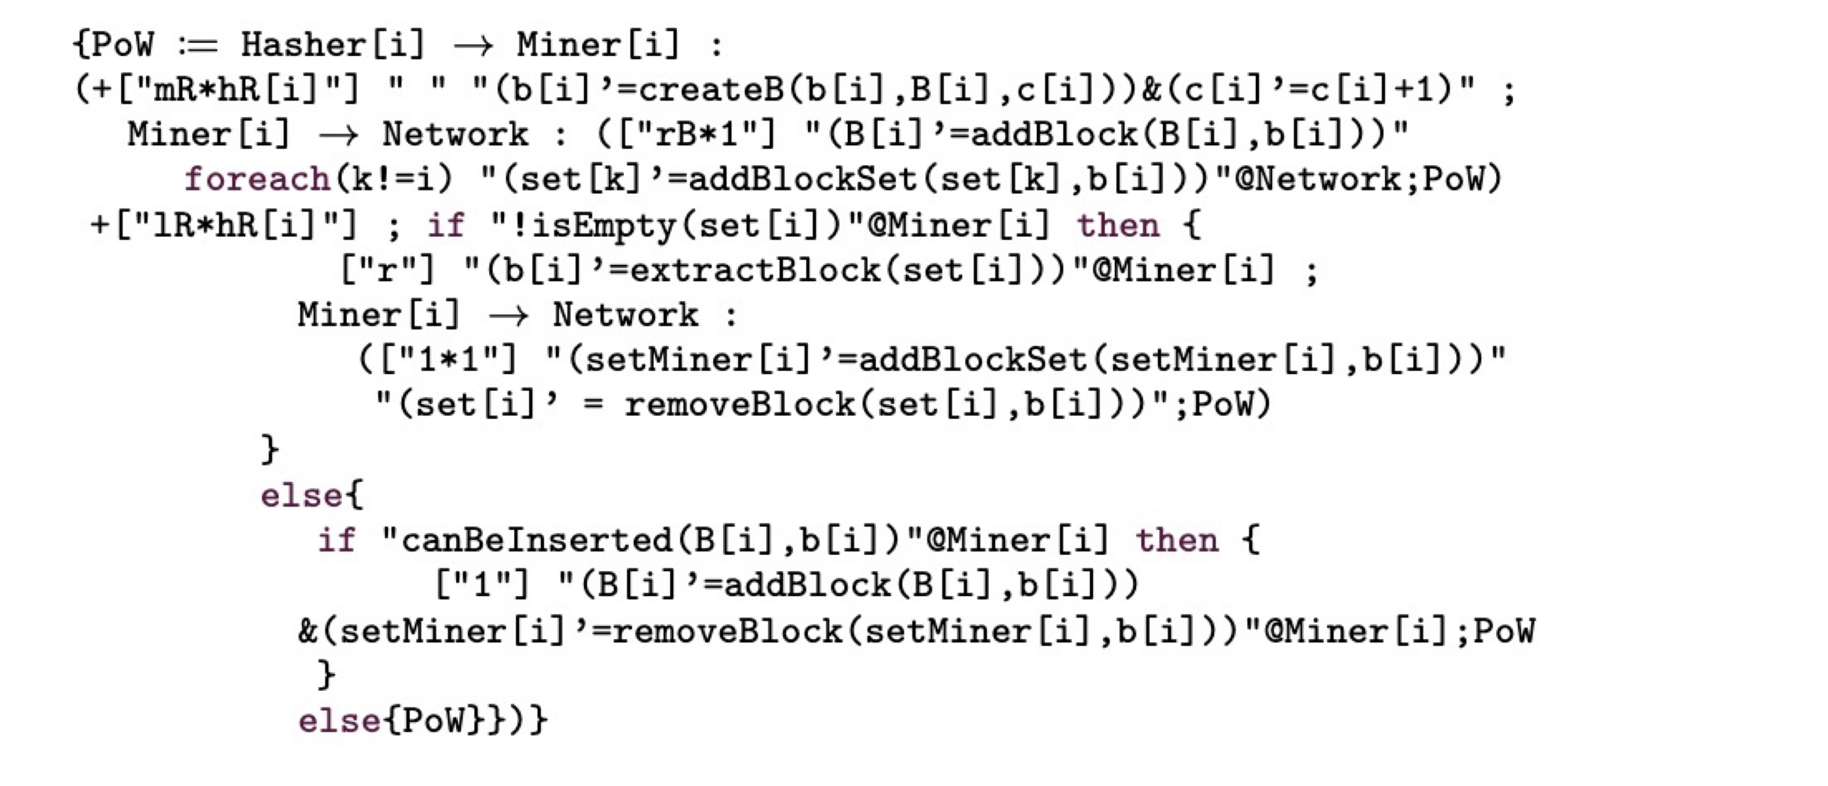
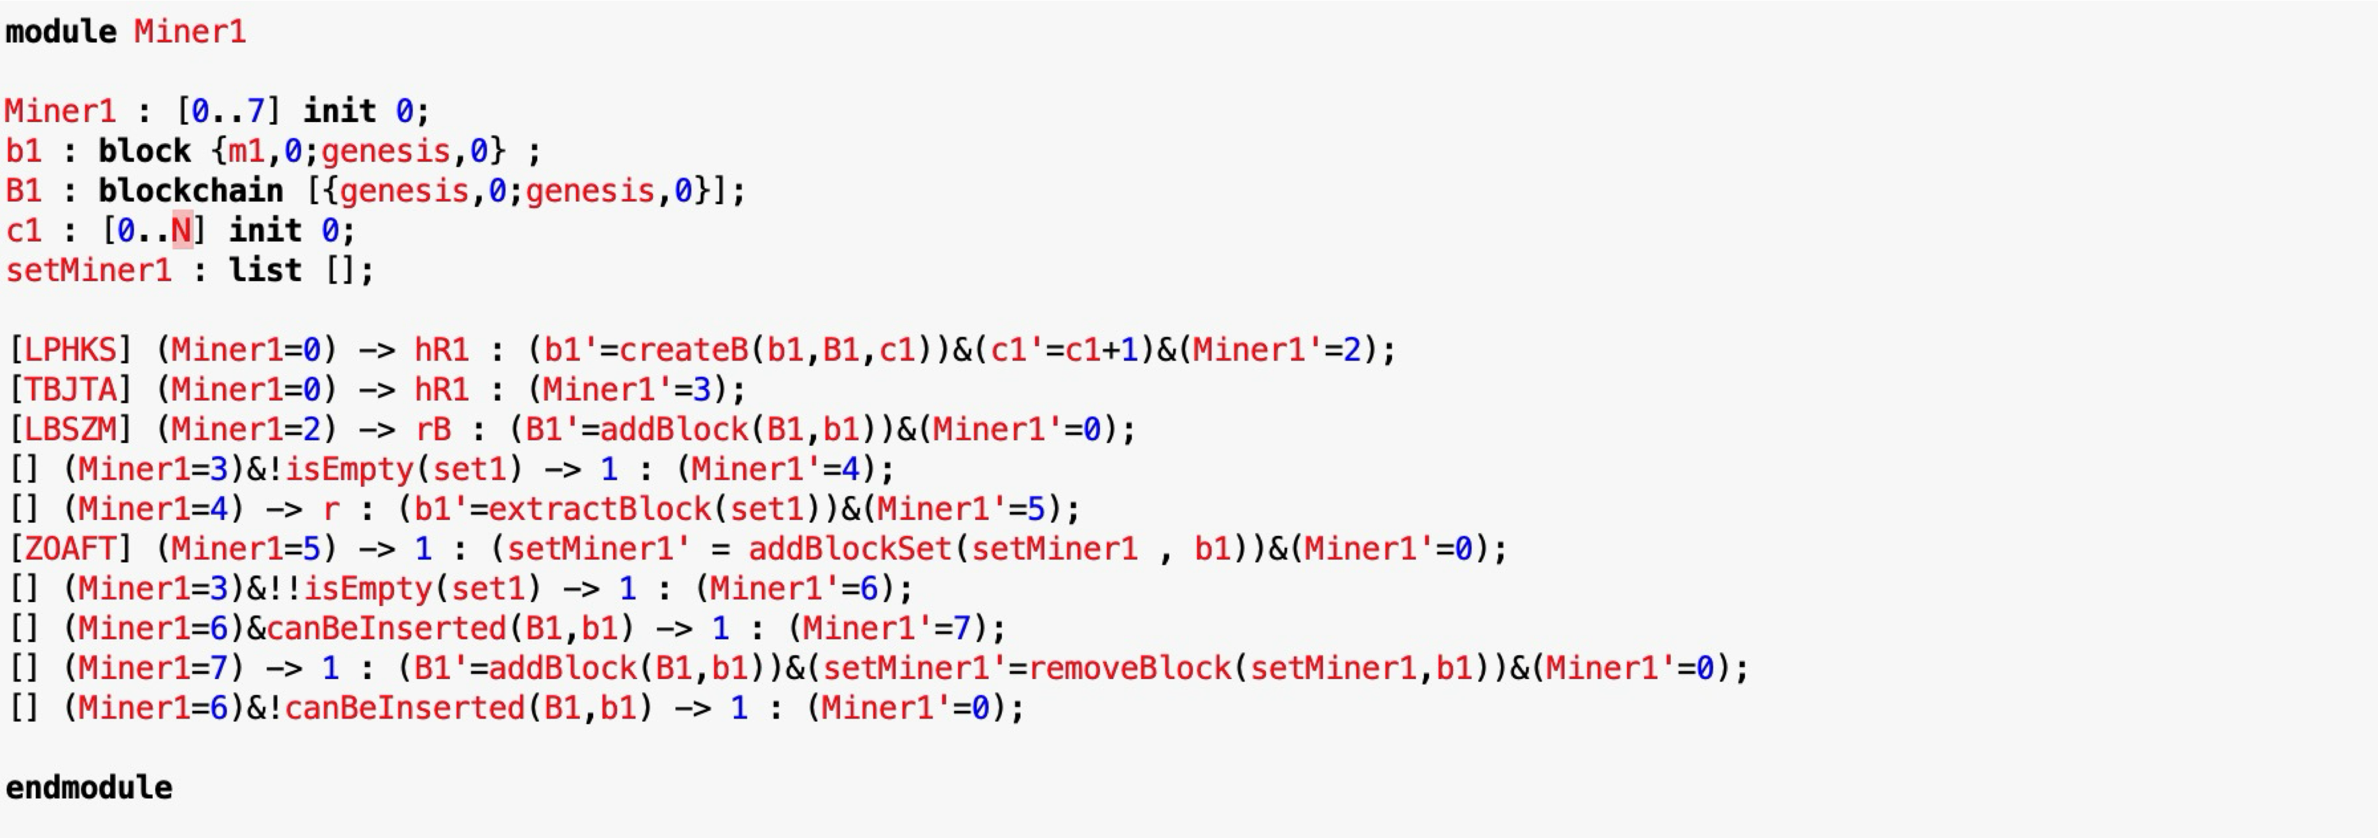
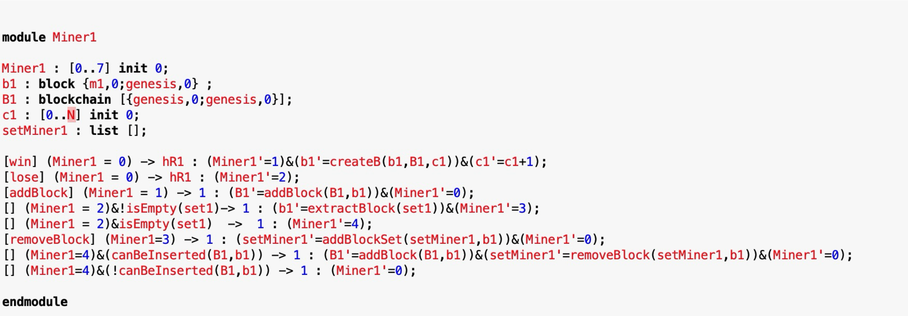
Bitcoin example
Original PRISM Model¹
Choreographic Model
Projected PRISM Model
[1] Stefano Bistarelli, Rocco De Nicola, Letterio Galletta, Cosimo Laneve, Ivan Mercanti, Adele Veschetti: Stochastic modeling and analysis of the bitcoin protocol in the presence of block communication delays. Concurr. Comput. Pract. Exp. 35(16) (2023)

Slide 29
Conclusions & next steps

Slide 30
Conclusions
We have developed a choreographic calculus
Probabilistic
Models concurrent probabilistic systems
Improved expressive clarity
Implemented and proved the correcteness of the projection

Slide 31
What’s next?
Extend the language
There are protocols we cannot model, especially those with internal branching
Extend the theory for the full language (and extensions)
Theoretical aspects only hold for a very core version of the language
Generate Markov chains directly from choreographies
PRISM needs to construct all possible interactions from single modules
A choreography knows that by definition
Can this improve performance dramatically?

Slide 32
THANK YOU!
Questions?
Adele Veschetti
adele.veschetti@tu-darmstadt.de

